Slide 1

Chatbot - ESAIP

Slide 2
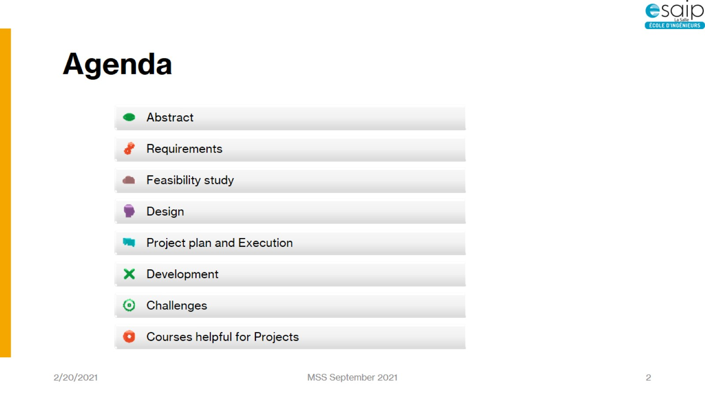
Agenda

Slide 3
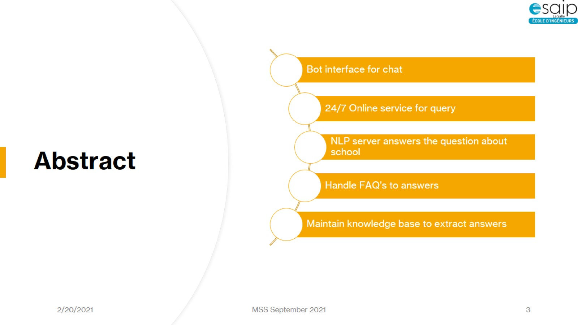
Abstract

Slide 4
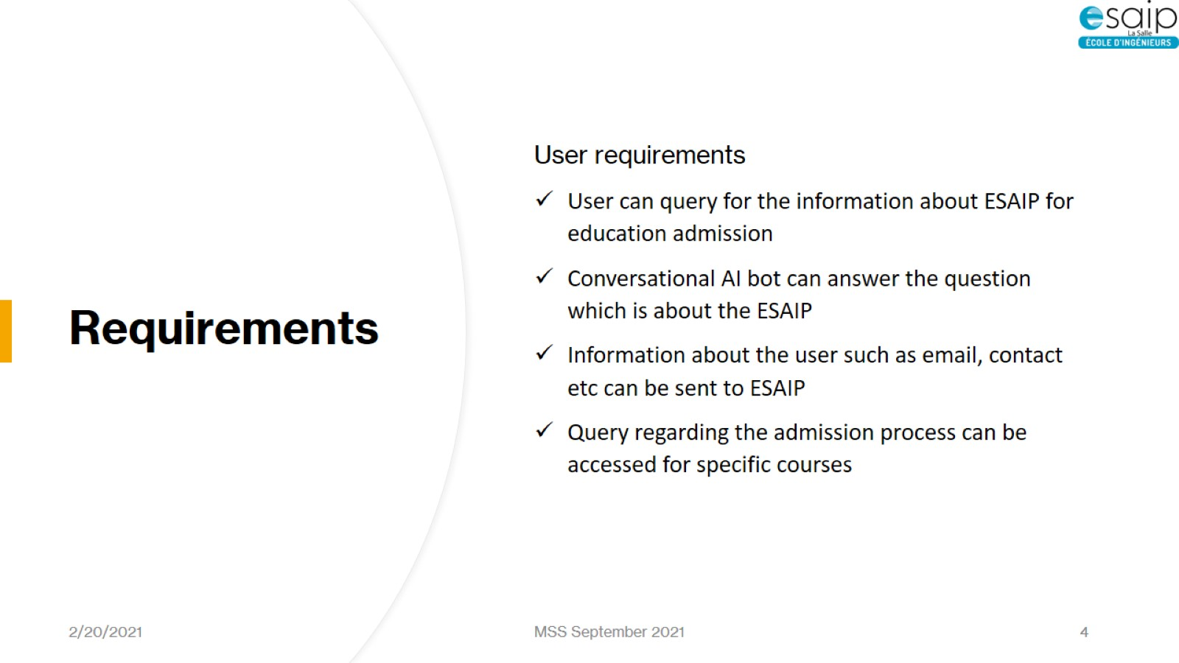
Requirements

Slide 5
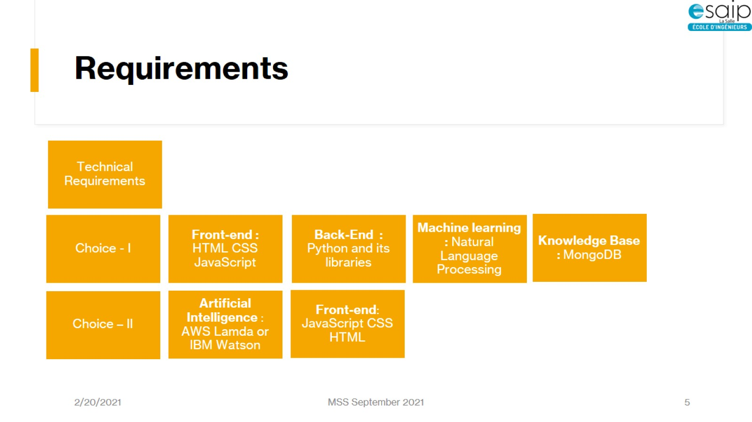
Requirements

Slide 6
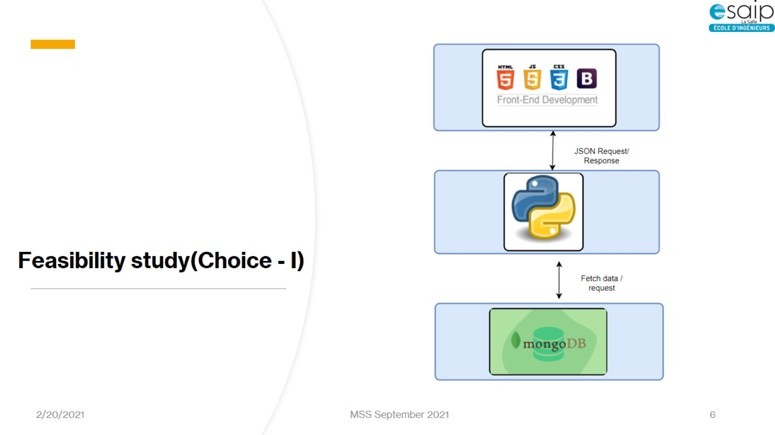
Feasibility study(Choice - I)

Slide 7
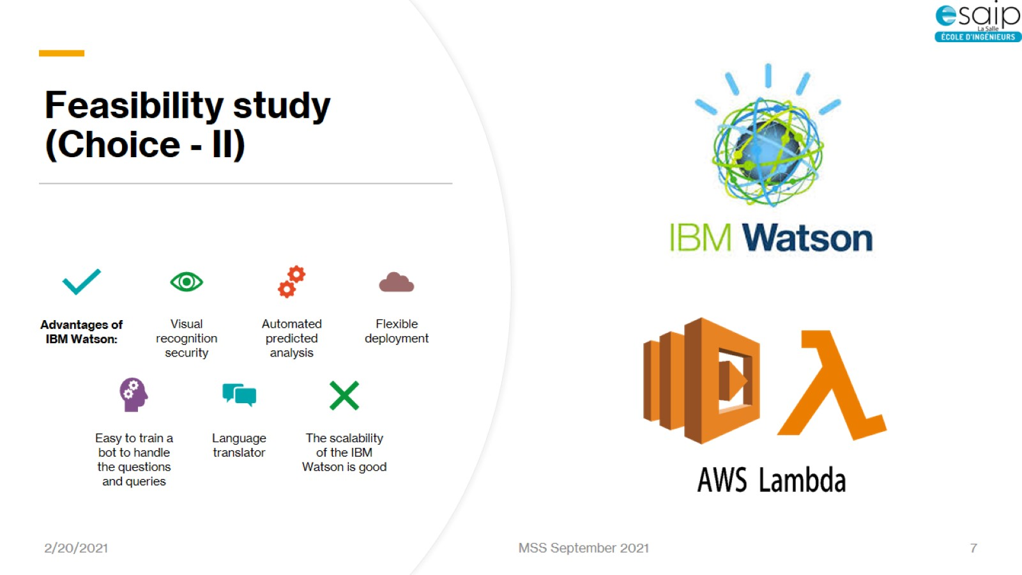
Feasibility study (Choice - II)

Slide 8
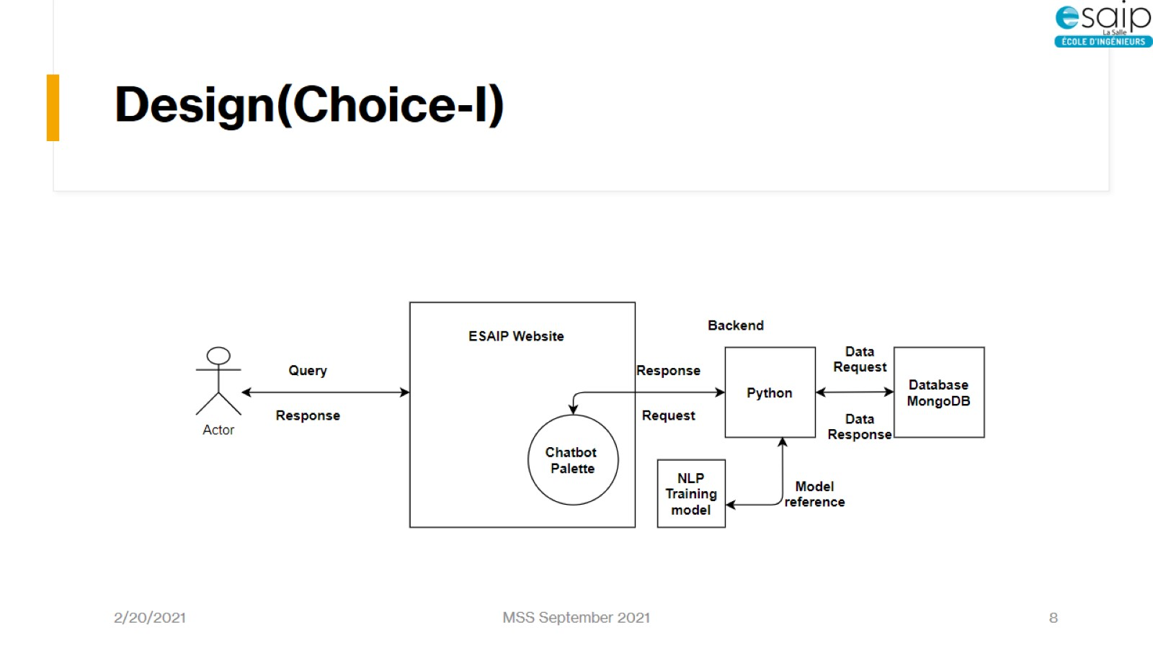
Design(Choice-I)

Slide 9
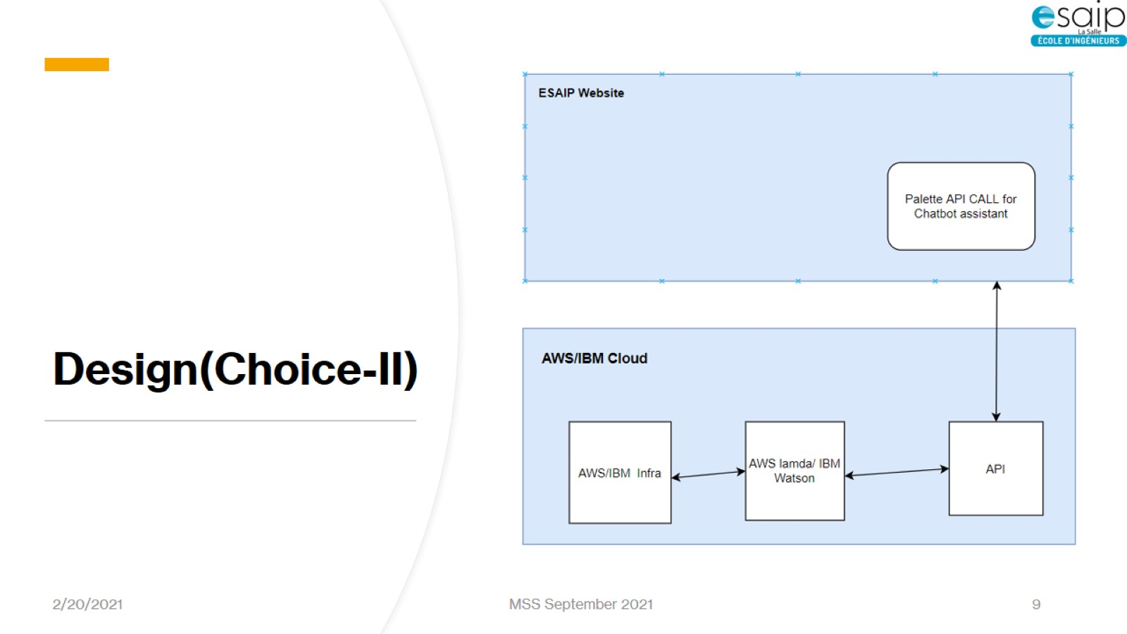
Design(Choice-II)

Slide 10
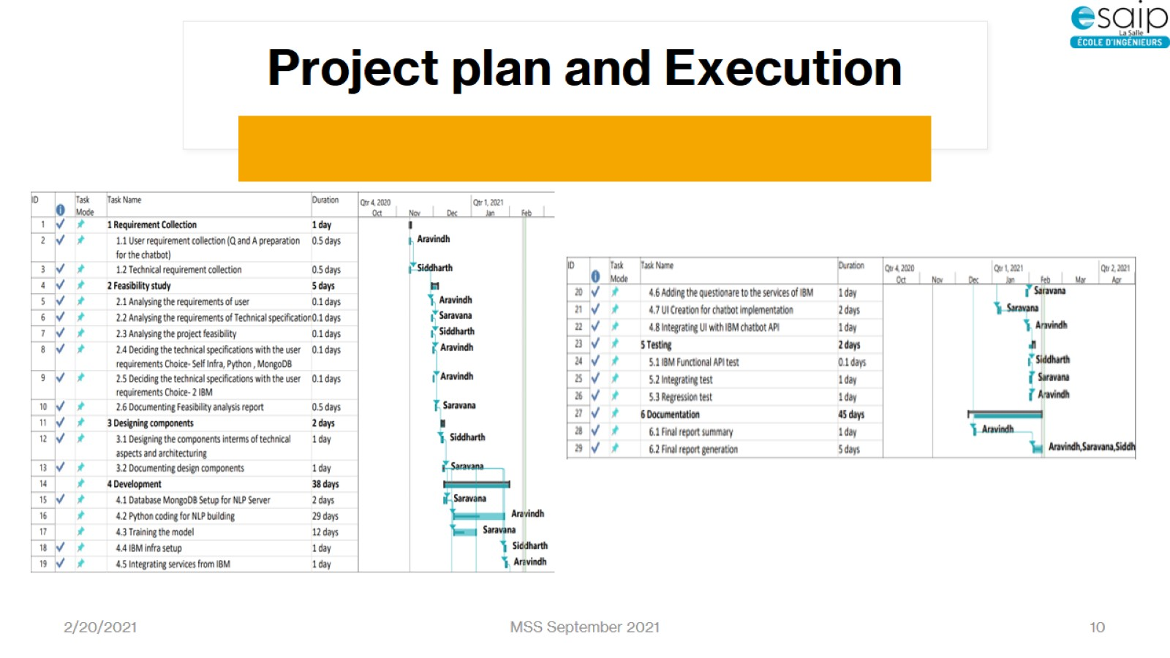
Project plan and Execution

Slide 11
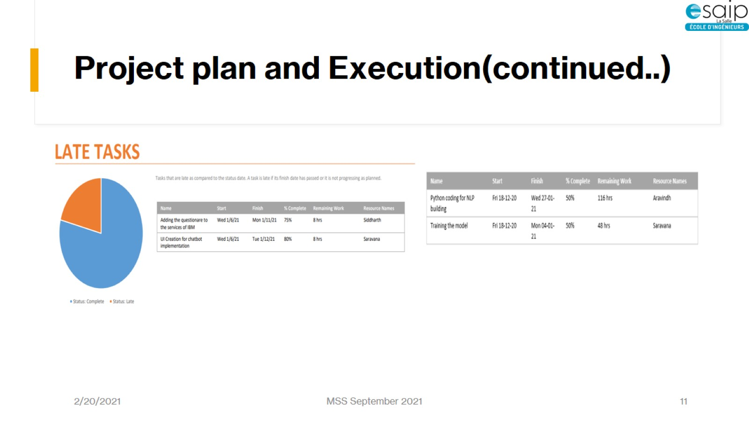
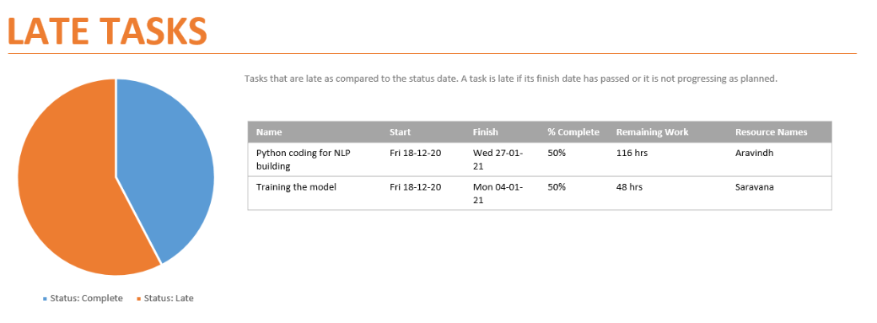
Project plan and Execution(continued..)

Slide 12
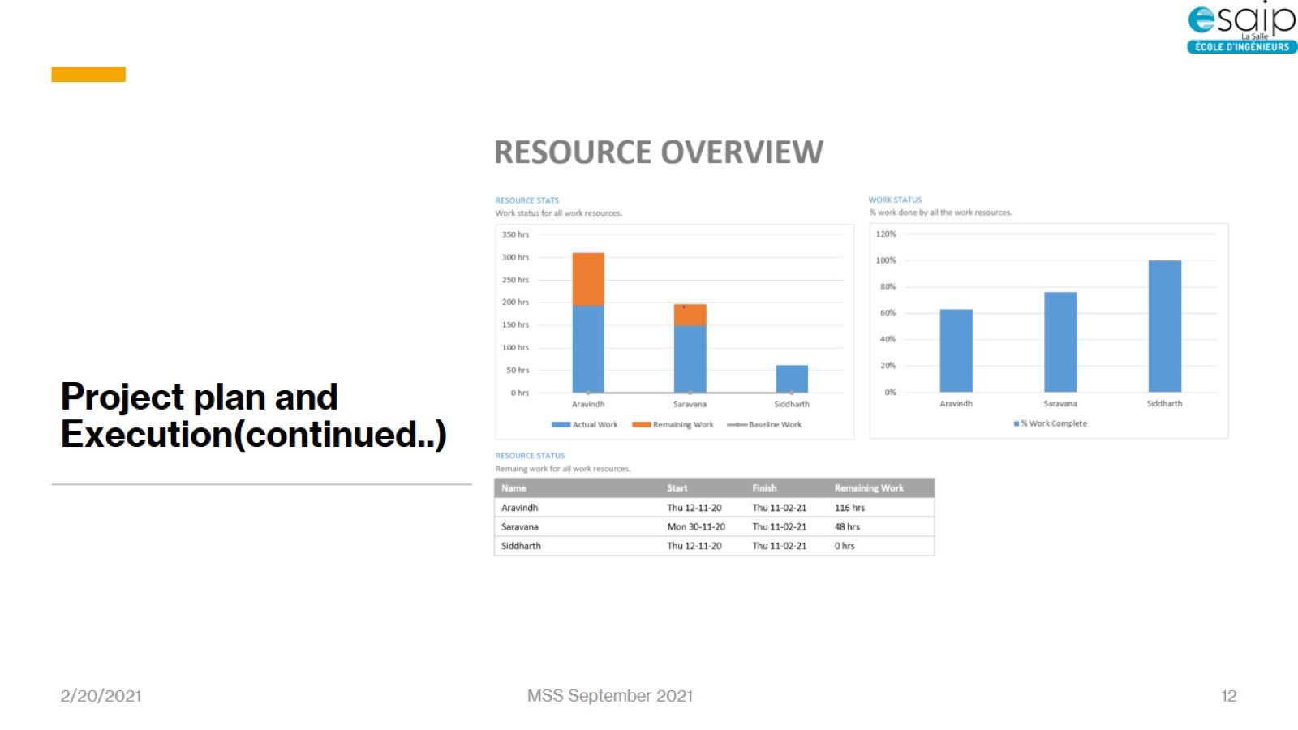
Project plan and Execution(continued..)

Slide 13
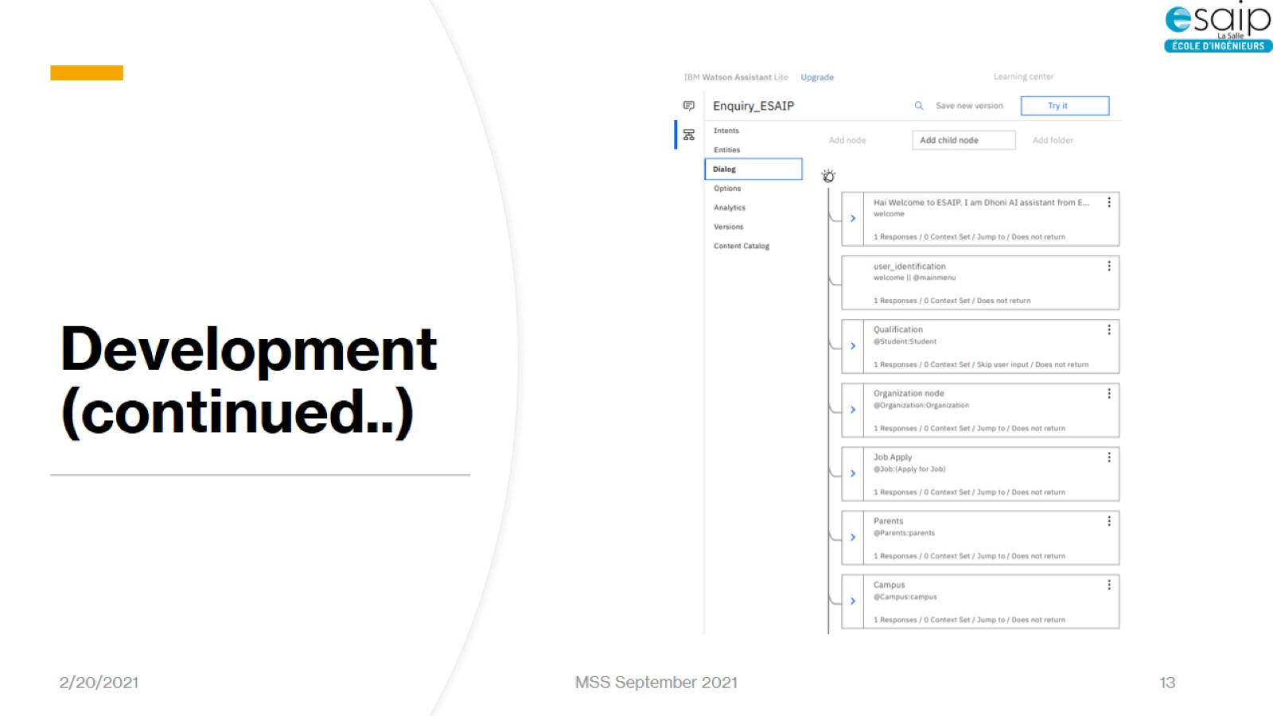
Development (continued..)

Slide 14
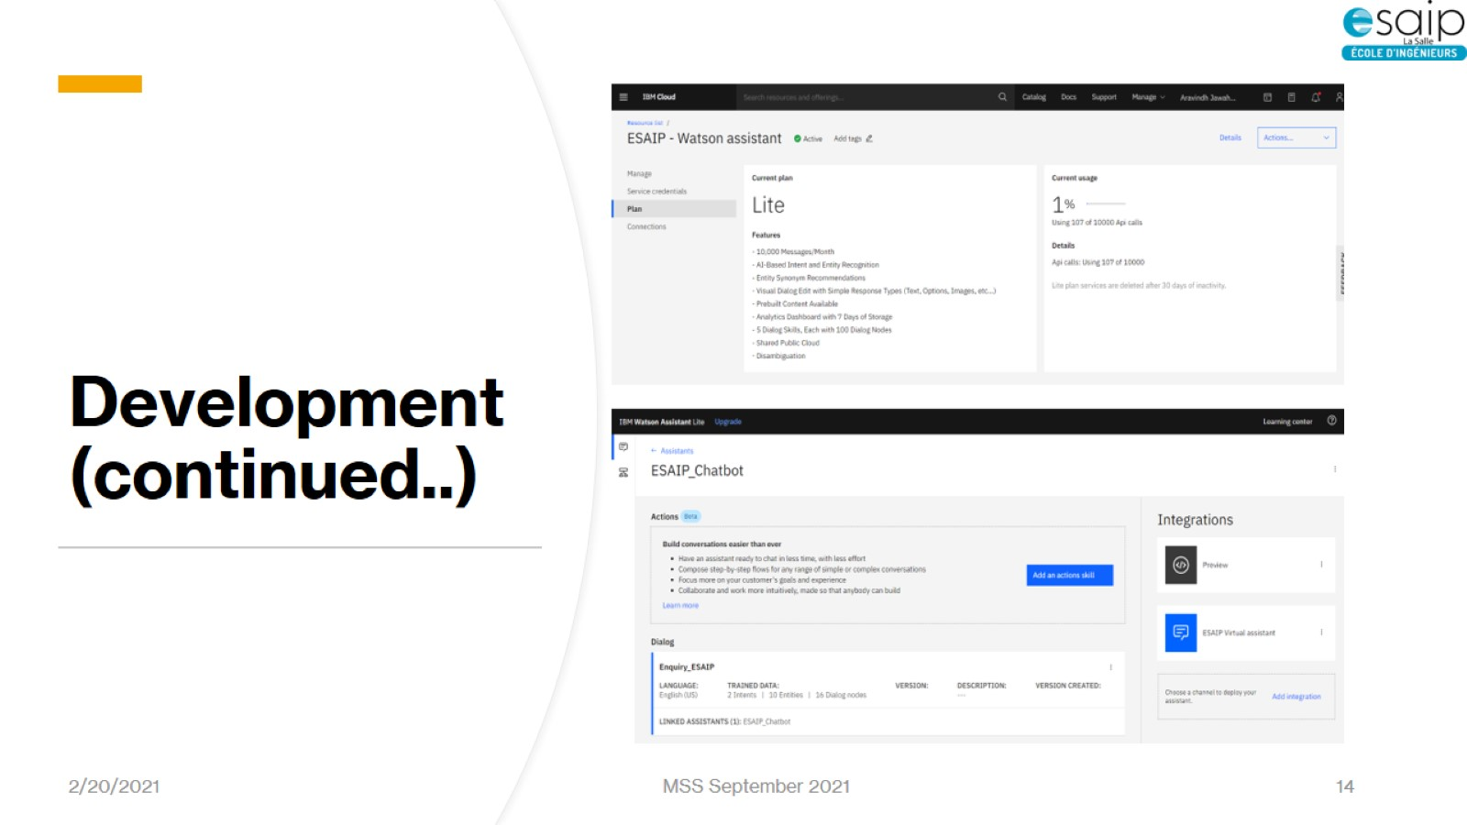
Development (continued..)

Slide 15
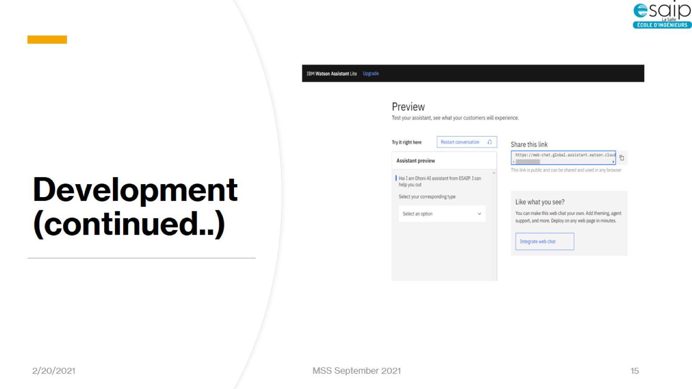
Development (continued..)

Slide 16
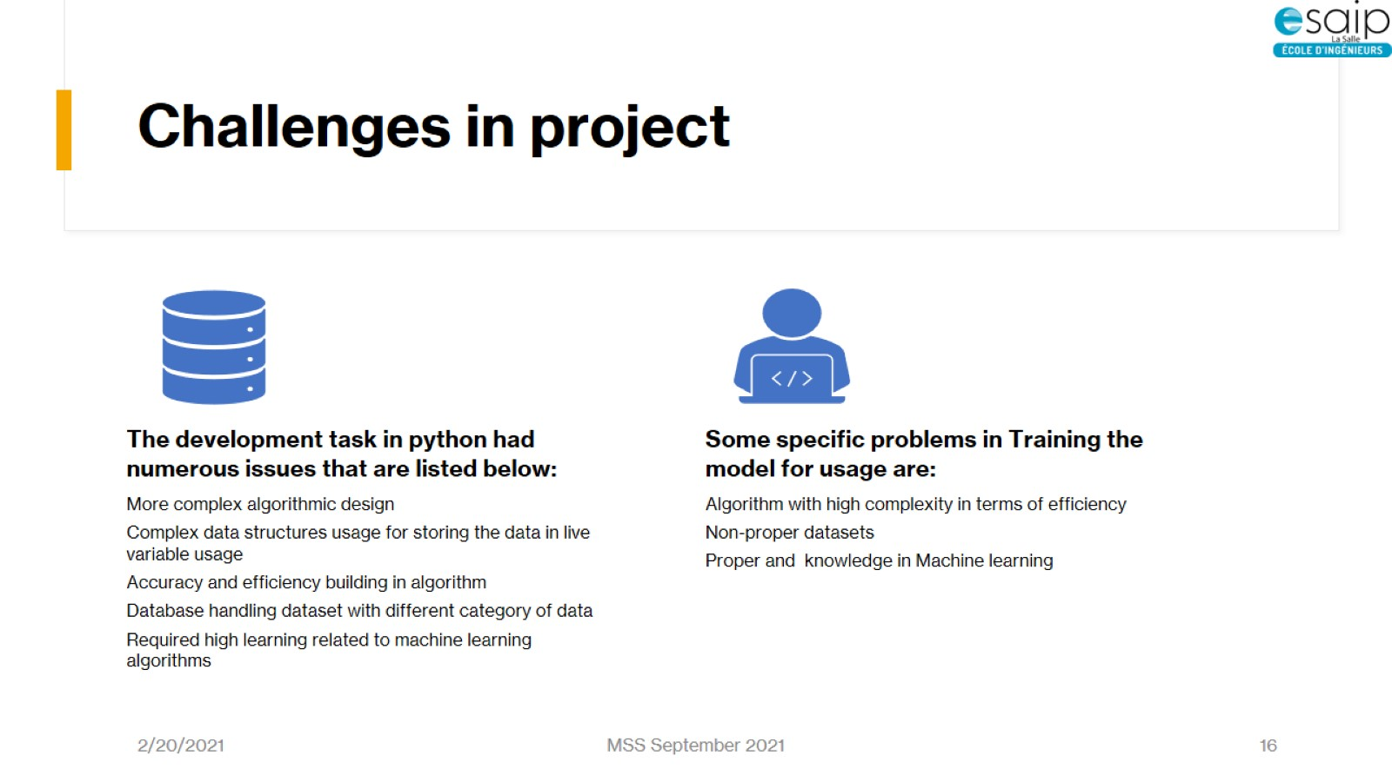
Challenges in project
More complex algorithmic design
Complex data structures usage for storing the data in live variable usage
Accuracy and efficiency building in algorithm
Database handling dataset with different category of data
Required high learning related to machine learning algorithms
Algorithm with high complexity in terms of efficiency
Non-proper datasets
Proper and knowledge in Machine learning

Slide 17
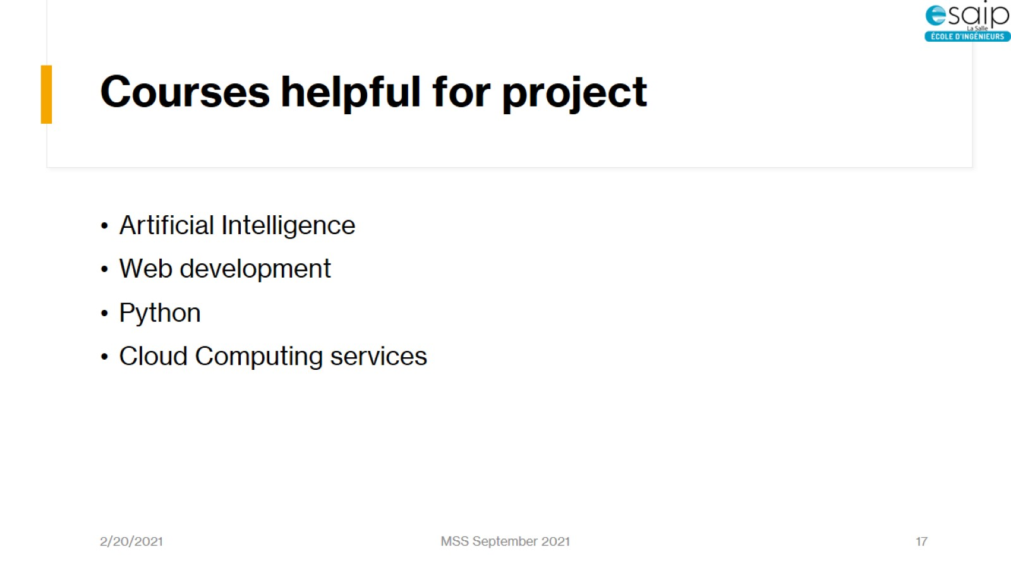
Courses helpful for project
Python
Cloud (Azure, IBM)
Artificial Intelligence
Web development
Project Management

Slide 18
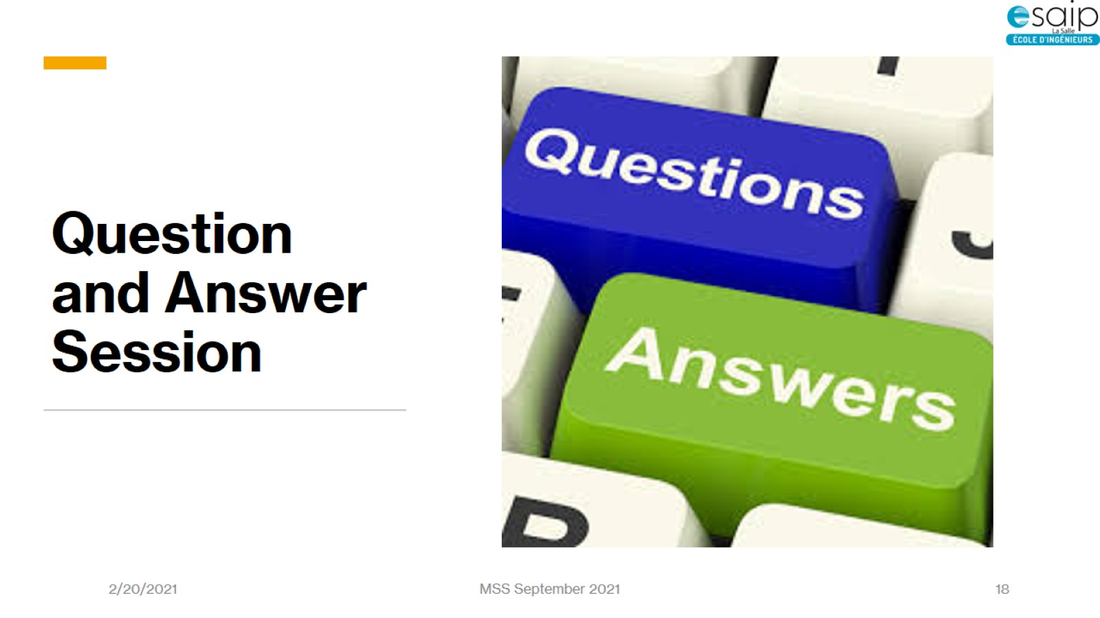
Question and Answer Session

Slide 19

Thank you

